Slide 1
Sorting Algorithms I
Comparisons-Based Algorithms
Notes:
Video Module 5-01

Slide 2

Overview
Objectives
Learn, understand , and analyze the InsertSort algorithm.
Learn, understand , and analyze the QuickSort algorithm.
Review the MergeSort algorithm.
Requirements
Review correctness: especially loop invariants
Read
Related material in Sections 2.1 and 2.2
Sections 7.1 and 7.2
Sections 2.3.1 and 2.3.2

Slide 3
Insert Sort Algorithm
How does InsertSort work?
Correctness of InsertSort
Read Section 2.1

Slide 4
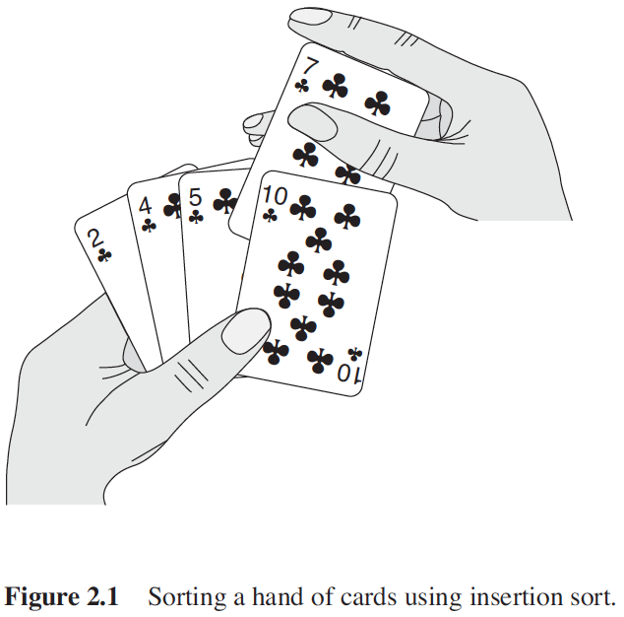

How Does InsertSort Work?
Start with an empty hand
Pick from a deck of cards (unsorted face down)
Place the picked card at the right place

Slide 5
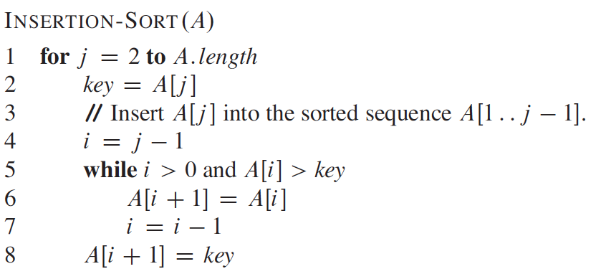
Insert-Sort Algorithm
Problem: Sort a sequence A
Solution: Insert-Sort(A)
Inputs: Sequence A
Output: Sorted A.

Slide 6
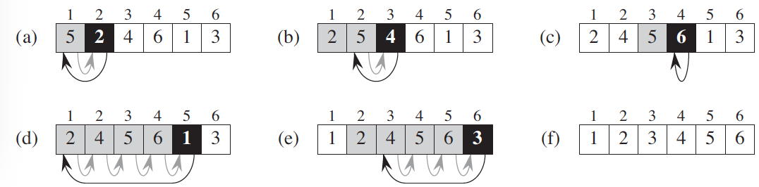
Insert-Sort Algorithm (Example)
Problem: Sort a sequence A
Solution: Insert-Sort(A)
Inputs: Sequence A
Output: Sorted A.

Slide 7
Insert-Sort Algorithm (Example)
Problem: Sort a sequence A
Solution: Insert-Sort(A)
Inputs: Sequence A
Output: Sorted A.

Slide 8
Insert-Sort Algorithm (Correctness)
Loop Invariant: Before each iteration of the for loop (lines 1-8), the subarray A[1..j-1] consists of the elements originally in A[1..j-1], but in sorted order.
Initialization: the first iteration starts with j=2. Before this iteration, the subarray a[1] consists of the of the element a[1] originally in the A[1]. Of course, it is sorted since the subarray contains only one element.
Maintenance: let us use induction. Suppose the loop invariant is true before the iteration j=m. Executing the loop will produce a sorted sequence A[1..j]=A[1..m that contains original elements of A[1..m]. Therefore, before the iteration j=m+1, A[1..m] sorted with the original elements. So, the loop invariant is true
Termination: when the loop ends, the loop invariant expresses exactly the property sought by this algorithm: the array A contains the initial elements in a sorted order. Insert-Sort is correct

Slide 9
Insert Sort Algorithm (Analysis)
InsertSort Analysis:
average case
worst case
Read Section 2.2
Notes:
Video Module 5-02

Slide 10
Insert-Sort Algorithm (Analysis)
Input Size?
n: number of elements in the sequence
Operation to count?
Comparison
n comparisons
2.t_{j} comparisons (tj depends on j)
What is t_{j}?

Slide 11
Insert-Sort Algorithm (Analysis): Best Case
Θ(n)
What is the value of t_{j}?
It depends on the input.
How is the input in the best case scenario?
The sequence A is sorted
1 | 2 | 3 | 4 | 5 | 6 | 7 | 8
3 | 6 | 7 | 10 | 13 | 15 | 17 | 20
n comparisons
2 comparisons (t_{j} = 2 for all j)

Slide 12
Insert-Sort Algorithm (Analysis): Worst Case
Θ(n²)
What is the value of t_{j}?
It depends on the input.
How is the input in the worst case scenario?
The sequence A is reverse sorted
1 | 2 | 3 | 4 | 5 | 6 | 7 | 8
20 | 17 | 15 | 13 | 10 | 7 | 6 | 3
n comparisons
2.j - 1 comparisons (t_{j} = j all the time)

Slide 13
Insert-Sort Algorithm (Space Analysis)
InsertSort sorts in place: it does not use additional space than the input A.
Used space is A: Θ(n)

Slide 14
QuickSort Algorithm
How does QuickSort work?
Read Section 7.1
Notes:
Video Module 5-03

Slide 15
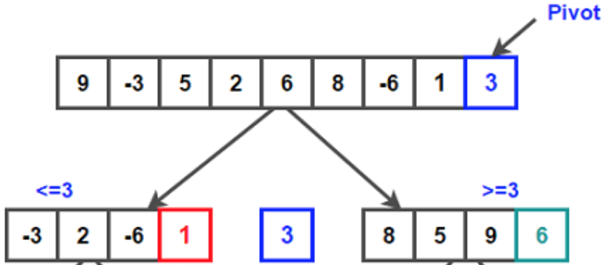
How Does QuickSort Work?
QuickSort uses the Divide-and-Conquer strategy:
Divide: Partition the array A[p..r] into two subarrays A[p.. q-1] and A[q+1.. r] such that each element of A[p.. q-1] is less than or equal to A[q], which is, in turn, less than or equal to each element of A[q+1.. r]. Compute the index q as part of this partitioning procedure.
Conquer: Sort the two subarrays A[p.. q-1] and A[q+1.. r] by recursive calls to quicksort.
Combine: Since the subarrays are already sorted after the recursive calls, no work will be needed to combine: A[p..r] will be sorted,

Slide 16
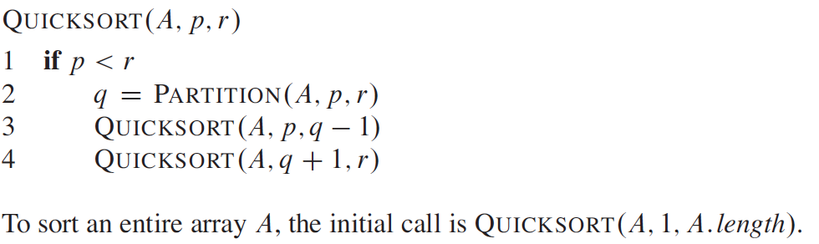
QuickSort Algorithm
Problem: Sort a sequence A
Solution: QuickSort(A, 1, A.length)
Inputs: Sequence A, Index first element 1, index last element A.length
Output: Sorted A.

Slide 17
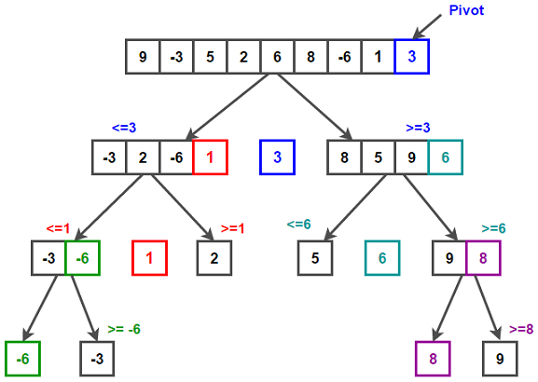
QuickSort Algorithm (Example)
Problem: Sort a sequence A
Solution: QuickSort(A, 1, A.length)
Inputs: Sequence A, Index first element 1, index last element A.length
Output: Sorted A.

Slide 18
QuickSort Algorithm (Example)
Problem: Sort a sequence A
Solution: QuickSort(A, 1, A.length)
Inputs: Sequence A, Index first element 1, index last element A.length
Output: Sorted A.

Slide 19
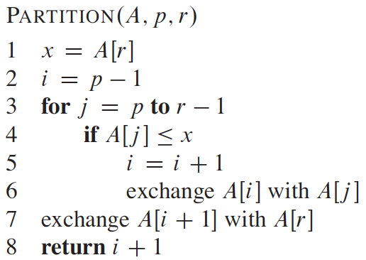
QuickSort Algorithm (The Partition Procedure) (1/2)
Problem: Partition a sequence A
Solution: Partition(A, p, r)
Inputs: Sequence A, Index first element p, index last element (pivot) r
Output: Index of pivot (between the subarrays).

Slide 20
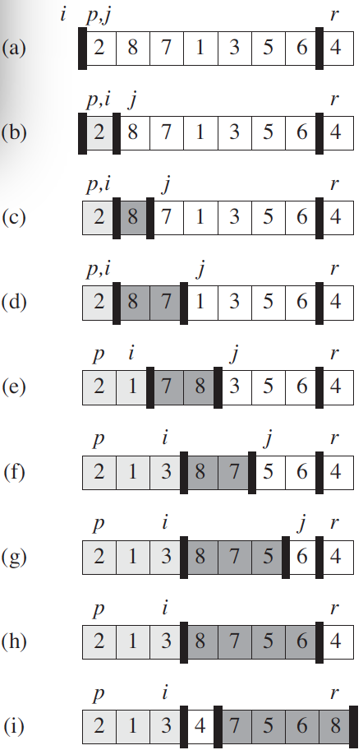
QuickSort Algorithm (The Partition Procedure) (2/2)
Problem: Partition a sequence A
Solution: Partition(A, p, r)
Inputs: Sequence A, Index first el.t p, index last elm.t (pivot) r
Output: Index of pivot (between the subarrays).
// x is the pivot
// place the pivot right at the “frontier”
// return the index of “frontier”
20

Slide 21
QuickSort Algorithm (The Partition Procedure) (2/2)
Problem: Partition a sequence A
Solution: Partition(A, p, r)
Inputs: Sequence A, Index first el.t p, index last elm.t (pivot) r
Output: Index of the pivot (between the subarrays).
// x is the pivot
// place the pivot right at the “frontier”
// return the index of “frontier”
21

Slide 22
QuickSort Correctness
Correctness of QuickSort
Read Section 7.1
Notes:
Video Module 5-04

Slide 23
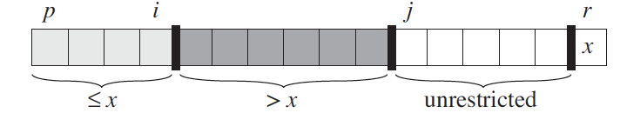
QuickSort: Partition Loop Invariants
Three loop invariants: before each iteration of the loop (lines 3-6), for any index k of Array A
if k = r, then A[k] = x
if p ≤ k ≤ i, then A[k] ≤ x
if i+1 ≤ k ≤ j-1, then A[k] > x
// x is the pivot

Slide 24
QuickSort: Partition Loop Invariants (Initialization)
Three loop invariants: before each iteration of the loop (lines 3-6), for any index k of Array A
if k = r, then A[k] = x
if p ≤ k ≤ i, then A[k] ≤ x
if i+1 ≤ k ≤ j-1, then A[k] > x
The assignment in Line 1 satisfies the Condition a).
Before the first iteration, i = p-1 and j = p.
Since no values between p and i or between i+1 and j-1, then conditions b). and c) are trivially satisfied.
// x is the pivot
i
j

Slide 25
QuickSort: Partition Loop Invariants (Maintenance)
Three loop invariants: before each iteration of the loop (lines 3-6), for any index k of Array A
if k = r, then A[k] = x
if p ≤ k ≤ i, then A[k] ≤ x
if i+1 ≤ k ≤ j-1, then A[k] > x
By induction, suppose that the three conditions hold before the current iteration. Let us prove that they will still hold before the next iteration.
Let us execute the loop
if A[j] ≤ x then i = i+1 (extend lightly shaded area) and exchange A[i] with A[j]
Otherwise (A[j] > x), do nothing (but dark area is extended to the right to include A[j])
// x is the pivot

Slide 26
QuickSort: Partition Loop Invariants (Termination)
Three loop invariants: before each iteration of the loop (lines 3-6), for any index k of Array A
if k = r, then A[k] = x
if p ≤ k ≤ i, then A[k] ≤ x
if i+1 ≤ k ≤ j-1, then A[k] > x
At termination, j=r. Looking at the figure, there no more “unrestricted” elements: all values in the array A are partitioned into the three sets: less than or equal to x, greater than x, and the singleton {x}. Line 7 exchange A[i+1] and A[r], putting the pivot right at the frontier between smaller and greater elements.
Conclusion: the Partition procedure is correct.
// x is the pivot

Slide 27
QuickSort Algorithm (Analysis)
QuickSort Analysis:
Partition Analysis
Worst case
Best case
Average case
Read Section 7.2
Notes:
Video Module 5-05

Slide 28
Review: QuickSort Algorithm (Example)
Problem: Sort a sequence A
Solution: QuickSort(A, 1, A.length)
Inputs: Sequence A, Index first element 1, index last element A.length
Output: Sorted A.

Slide 29
QuickSort Algorithm (Analysis)
Input Size?
n: number of elements in the sequence (from index p to index r)
Operation to count?α(i)
?
This is a divide-and-conquer algorithm, so
we will use the same method used for MergeSort (recursive algorithm):
Define T(n) as the running time of QuickSort(A,p,r)
T(n)
Running time of Partition
T(α_{i}n)
0 ≤α_{i} ≤ 1)
T((1-α_{i})n)

Slide 30
Partition Analysis
Θ(n)
Input Size?
n: number of elements in the sequence (from index p to index r)
Operations to count?
Comparisons (if A[j] ≤ x)
The loop (Lines 3-6) is executed (n-1) times
Running time of Partition is then Θ(n)

Slide 31
QuickSort Algorithm (Analysis)
T(n)
Θ(n)
T(α_{i}n)
0 ≤α_{i} ≤ 1)
T((1-α_{i})n)
How to choose α_{i}?
α_{i} varies with each recursive call and depends on the original order of the elements in the sequence.
What to do?
Look at extreme cases.
Case 1: at each recursive call, one of the subarray is empty (unbalanced partition). Worst case
Case 2: at each recursive call, the sequence is divided in two equal subarrays (balanced partition). Best case.

Slide 32
QuickSort (Analysis): Worst Case (Unbalanced)
Θ(n²)
T(n)
Θ(n)
T(n-1)
T(0)
Let us express T(n)
If the partition is unbalanced,
one subarray will have (n-1) elements
the other subarray will have 0 elements.
Therefore, the recurrence relation is
Since T(0) is constant (Θ(1)), then
Then T(n) = T(n-2) + Θ(n-1) + Θ(n)
T(n) = T(n-3) + Θ(n-2) + Θ(n-1) + Θ(n) = ….....
T(n) = T(n-1) +T(0)+Θ(n)
T(n) = T(n-1) + Θ(n)

Slide 33
QuickSort (Analysis): Best Case (balanced)
Θ(n lg n)
T(n)
Θ(n)
T(n/2)
T(n/2)
Let us express T(n)
If the partition is balanced,
one subarray will have n/2 elements (ignoring floor/ceiling details)
the other subarray will have n/2 elements.
Therefore, the recurrence relation is
Using the Master method, Case 2 applies and yields
T(n) = Θ(n lg n)
T(n) = 2T(n/2) +Θ(n)

Slide 34
QuickSort : Average Case (Analysis)
Θ(n lg n)
T(n)
Θ(n)
T(α_{i}n)
0 ≤α_{i} ≤ 1)
T((1-α_{i})n)
How does α_{i} vary from call to call?
Some partitions will be balanced while others won’t be….
It is unlikely to systematically have one of the subarray empty
So, statistically, there will be some compensation....
Conclusion
On average, T(n) = Θ(n lg n).

Slide 35
QuickSort : Space Analysis
Θ(n)
QuickSort is an in place algorithm: it sorts the A input without using additional space to store A.
The array A contains n elements, therefore space takes Θ(n).

Slide 36
MergeSort Review
MergeSort Review
Read Sections 2.3.1 and 2.3.2
Notes:
Video Module 5-06

Slide 37
MergeSort Review
Θ(n lg n)
Problem: Sort a sequence A
Solution: Merge-Sort(A, p, r)
Inputs: Sequence A, index p of first element and index r of last element
Output: Sorted A.
Merge-Sort(A, p, r)
if (p < r) //subsequence has more than one element
q = floor((p+q)/2) // q is the midpoint
Merge-Sort(A, p, q)
Merge-Sort(A, q+1, r)
Merge(A, p, q, r)) // Combine
MergeSort uses a Divide-and-Conquer strategy
Running time T(n) = Θ(n lg n).
Space takes Θ(n) (MergeSort is not in place: recall the L and R arrays used by the Merge procedure)

Slide 38
Performance Summary (Comparison-Based Sorting)
Algorithm | Best Case | Average Case | Worst Case
InsertSort | Θ(n) | Θ(n²) | Θ(n²)
MergeSort | Θ(n lg n) | Θ(n lg n) | Θ(n lg n)
QuickSort | Θ(n lg n) | Θ(n lg n) | Θ(n²)
Any Comparison-based |  |  | Ω(n lg n)

Slide 39
Wrap Up
Learn, understand , and analyze the InsertSort algorithm.
Running time: best case (Θ(n)), average/worst cases (Θ(n²))
Space: in place, (Θ(n))
Learn, understand , and analyze the QuickSort algorithm.
Running time: best/average cases (Θ(n lg n)), worst case (Θ(n²))
Space: in place, (Θ(n))
Review the MergeSort algorithm.
Running time: best/average/worst cases (Θ(n lg n))
Space: (Θ(n)), NOT in place
Establish and understand the lower bounds of comparisons-based sorting algorithms.
T(n) = Ω(n lg n)
Algorithm | Best Case | Average Case | Worst Case
InsertSort | Θ(n) | Θ(n²) | Θ(n²)
MergeSort | Θ(n lg n) | Θ(n lg n) | Θ(n lg n)
QuickSort | Θ(n lg n) | Θ(n lg n) | Θ(n²)
Any Comparison-based |  |  | Ω(n lg n)
Notes:
Video Module 5-07

